Slide 1
Computer Architecture: Graduate Lab Report
Jiaqi Gu (jg68999)
Yuesen Lu (YL33489)

Slide 2
Outline
Summary of RRIP
SimPoint Setup
Quantitative Evaluation
Analysis

Slide 3
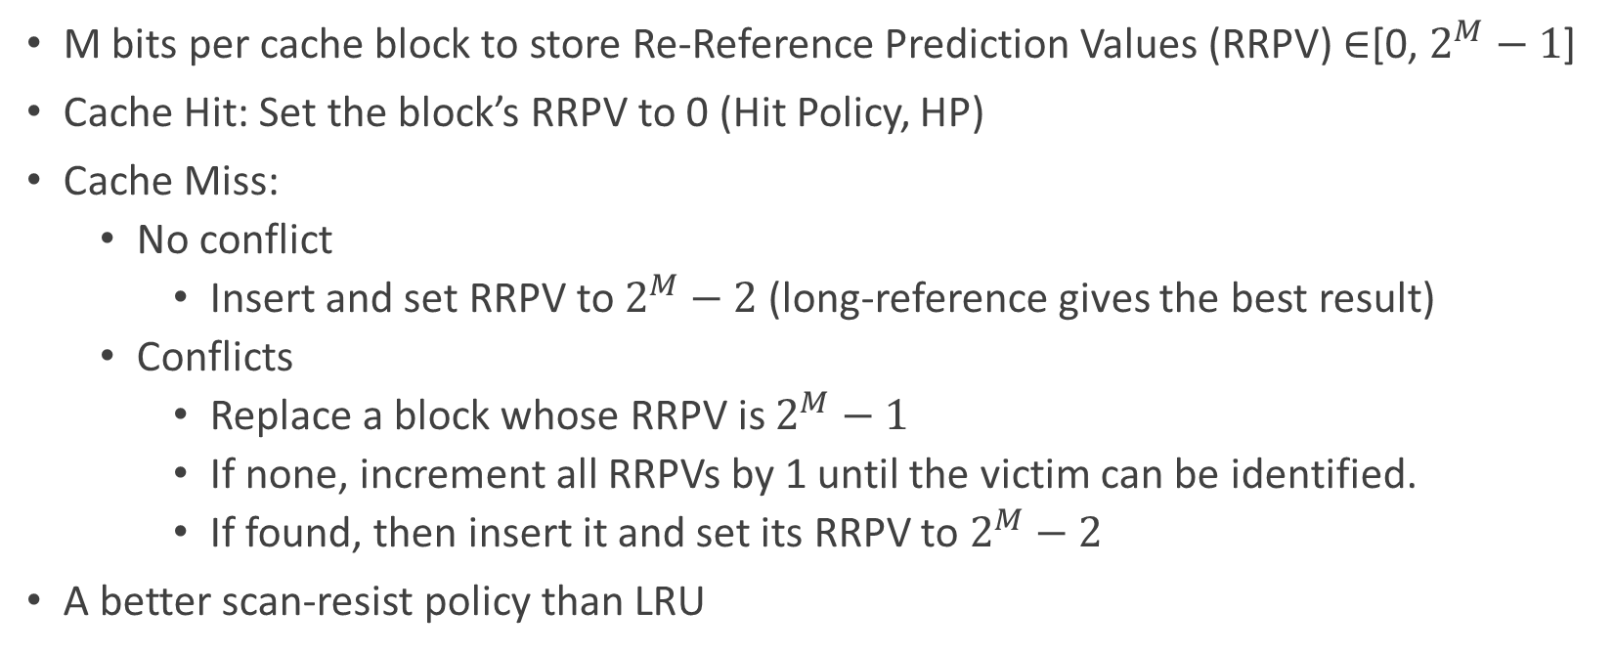
1.1 SRRIP Cache Replacement Policy
M bits per cache block to store Re-Reference Prediction Values (RRPV) ∈[0, $2^{M}−1$]
Cache Hit: Set the block’s RRPV to 0 (Hit Policy, HP)
Cache Miss:
No conflict
Insert and set RRPV to $2^{M}−2$ (long-reference gives the best result)
Conflicts
Replace a block whose RRPV is $2^{M}−1$
If none, increment all RRPVs by 1 until the victim can be identified.
If found, then insert it and set its RRPV to $2^{M}−2$
A better scan-resist policy than LRU

Slide 4
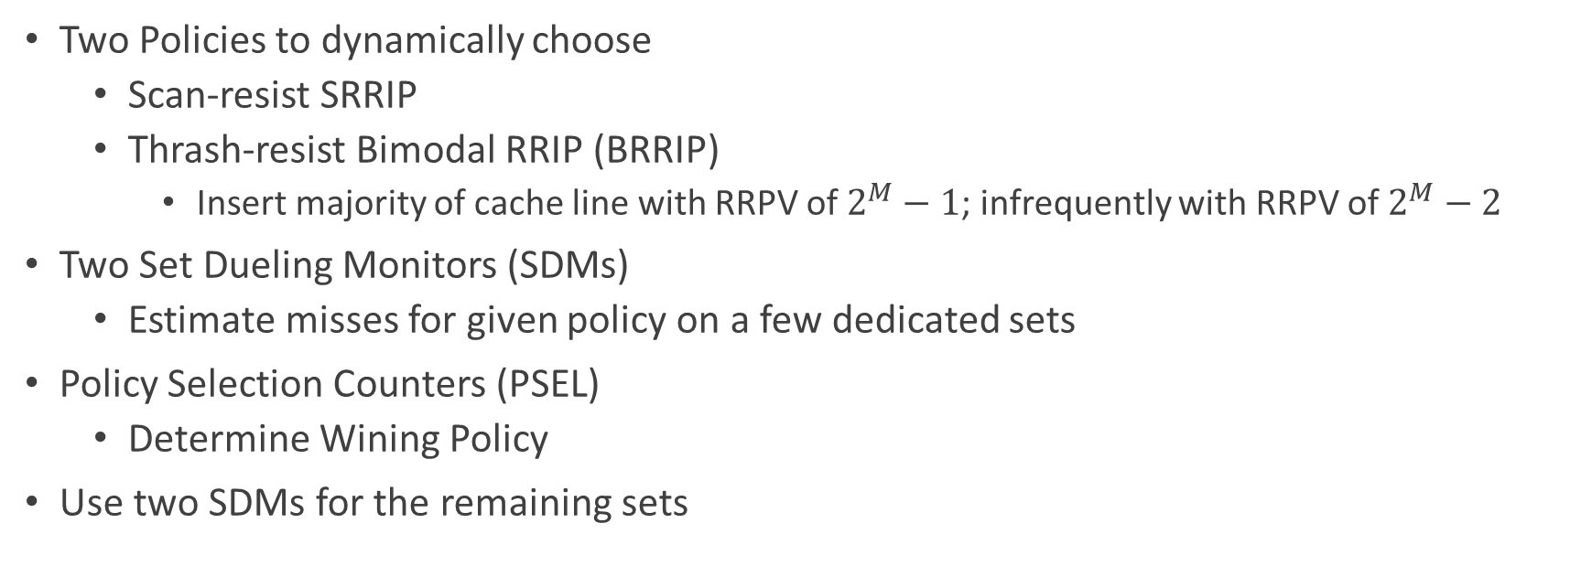
1.2 DRRIP Cache Replacement Policy
Two Policies to dynamically choose
Scan-resist SRRIP
Thrash-resist Bimodal RRIP (BRRIP)
Insert majority of cache line with RRPV of $2^{M}−1$; infrequently with RRPV of $2^{M}−2$
Two Set Dueling Monitors (SDMs)
Estimate misses for given policy on a few dedicated sets
Policy Selection Counters (PSEL)
Determine Wining Policy
Use two SDMs for the remaining sets

Slide 5
2. SimPoint Setup
bzip2
cactusADM
Cluster | Icount* | Weights
1 | 8070001932 | 0.11240
2 | 18120004274 | 0.10975
3 | 3090000819 | 0.08760
4 | 23790005563 | 0.20397
5 | 51780011854 | 0.48628
Cluster | Icount | Weights
1 | 278250248589 | 0.00205
2 | 2280152045099 | 0.27847
3 | 186330166230 | 0.71948
Length of SimPoints: 30 Million
Skip first 1 million instructions
Max cluster number (K): 5
*Icount: start instruction of that trace

Slide 6
2. SimPoint Setup
hmmer
mcf
Cluster | Icount | Weights
1 | 40980020068 | 0.58558
2 | 317520157280 | 0.24296
3 | 368940182854 | 0.02510
4 | 342870169847 | 0.14630
Cluster | Icount | Weights
1 | 57840010926 | 0.42404
2 | 116520019948 | 0.28964
3 | 267660041304 | 0.21647
4 | 95160014702 | 0.06984

Slide 7
2. SimPoint Setup
sphinx3
Cluster | Icount | Weights
1 | 1641630399809 | 0.21044
2 | 137700030560 | 0.12626
3 | 1045680248842 | 0.19970
4 | 1038870247205 | 0.12612
5 | 2087850516085 | 0.33748

Slide 8

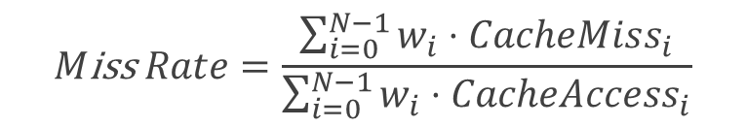
3.1 Quantitative Evaluation Metrics
Miss Rate
When an attempt to read or write data from the cache is unsuccessful, it results in lower level or main memory access and results in a longer latency. A better cache replacement policy should have lower miss rate.
$$M\text{iss} Rate=\frac{\sum_{i=0}^{N−1}{w_{i}⋅CacheMiss_{i}}}{\sum_{i=0}^{N−1}{w_{i}⋅CacheAccess_{i}}}$$
Cycle Per Instruction, CPI
It is the average cycles per instruction in a given process. A better cache replacement policy should have lower CPI.
$$CPI=\sum_{i=0}^{N−1}{w_{i}⋅CPI_{i}}$$
N: total number of traces
i: index of trace
w: weight of a trace

Slide 9
3.2 Methodology
Use Runspec to generate reference input and executable files of benchmarks
Use PinPoints to generate SimPoints of five benchmarks
Use Champsim_tracer file to generate tracer required by Pin tool later
Use Pin and tracer to generate trace of each SimPoint
Use Champsim to simulate based on the traces generated before

Slide 10
3.3 System Configuration
Configurations | Options
Branch Prediction | Bimodal
L1 Data Cache Prefetcher | No Next_Line
L2 Coherent Cache Prefetcher | No Lp_Stride
LLC Replacement Policy | LRU SRRIP DRRIP
Core | 1
LLC Size | (16way): 256KB 512KB 1024KB 2048KB
LLC Set-associativity | (1024KB): 8 16 32
LLC Cache Block (Byte) | 8

Slide 11
3.4 Simulation Configuration
ChampSim Simulation
Trace Length = 30 million
Warm-up Length = 1 million
Simulate on all traces with different system configurations.

Slide 12
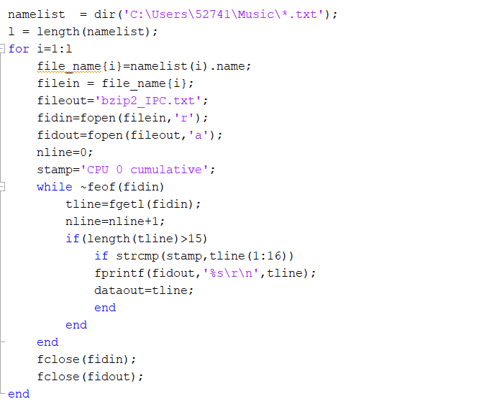
3.5 Data Collection
Extract by MATLAB Script
CPU 0 cumulative IPC
LLC TOTAL MISS
LLC TOTAL ACCESS

Slide 13
Miss Rate Evaluation

Slide 14
Miss Rate Evaluation

Slide 15
S-Curve

Slide 16
CPI Evaluation

Slide 17
CPI Evaluation

Slide 18
S-Curve

Slide 19
4.1 Analysis
Different Cache Size
Generally larger cache size leads to smaller miss rate and smaller CPI
The improvement caused by RRIP is not very sensitive to cache size in our experiments, except for mcf. Because the cache size we use is smaller than or equal to the working set of those workloads (2M), thus a better replacement policy will have better performance as it resolves capacity miss.
Among different cache size, we can see DRRIP achieves better performance than SRRIP in CPI and miss rate under most cases.
When cache size is small, e.g. 256 KB, sometimes RRIP will lead to higher miss rate and higher CPI than LRU.
RRIP achieves highest improvement when cache size is 512KB, because larger cache size will decrease the value of better replacement policy.

Slide 20
4.1 Analysis
Different Set Associativity
In most cases, RRIP gains a little bit higher performance improvement in larger set-associativity. But this trend may be due to different access patterns.
DRRIP is more sensitive to set associativity than SRRIP, especially on mcf benchmark

Slide 21
4.1 Analysis
w./w.o. Prefetcher
In most cases, prefetcher will improvement the performance, except for sphinx3.
CPI gets more benefit from prefetcher than miss rate.
Without prefetcher, RRIP can achieve more performance improvement than with prefetcher.

Slide 22
4.2 Conclusion and Recommendation
Both DRRIP and SRRIP have slightly lower miss rate and lower CPI than LRU on most benchmarks. And DRRIP has better performance than SRRIP on most benchmarks.
In some cases, RRIP achieves worse miss rate and CPI than LRU. One possible reason is that the locality over long-interval re-reference in these benchmarks rarely happens. So the advantage of RRIP is not fully utilized.
Generally, appropriate cache size and more set-associativity will fully utilize the benefits from RRIP.
RRIP are recommended to be used in appropriate LLC cache with larger set-associativity, while the application running on the system should have long-reference locality and scanning patterns.

